Slide 1

Activities & Intents
Maxim Leykin (maxim.leykin@gmail.com)

Slide 2
Android Application
Components

Slide 3

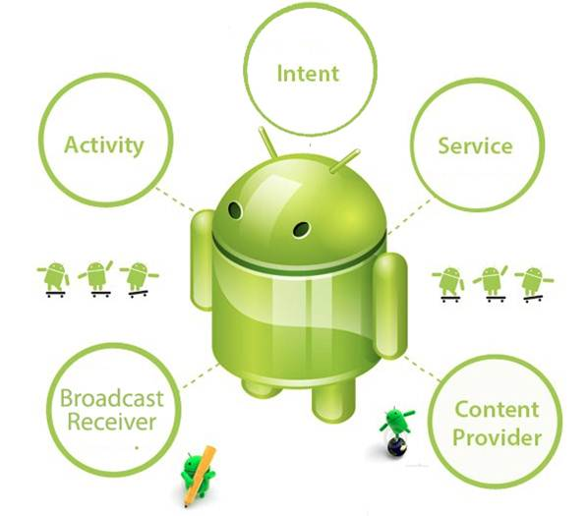
Main components of Android application

Slide 4
Activities

Slide 5
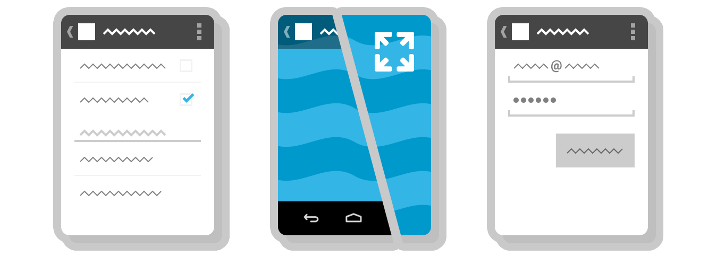
What is Activity?
An activity represents a single screen with a user interface just like window or frame of Java. Almost all activities interact with the user, so the Activity class takes care of creating a window for you in which you can place your UI with setContentView(View). While activities are often presented to the user as full-screen windows, they can also be used in other ways: as floating windows (via a theme with windowIsFloating set) or embedded inside of another activity (using ActivityGroup).

Slide 6
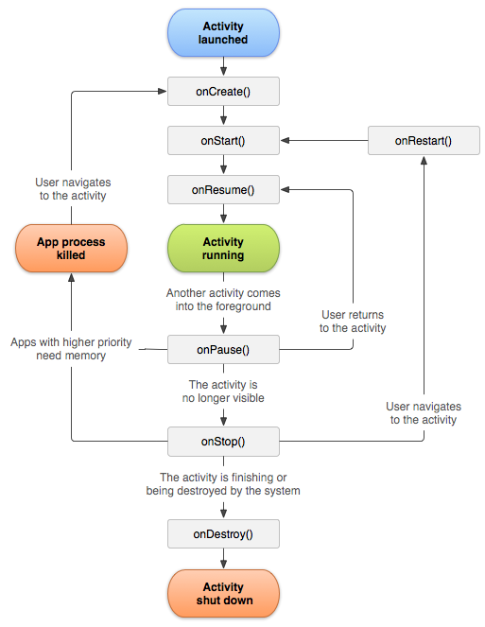
Activity: States
An activity has essentially four states:
Active (Running) - if an activity is in the foreground of the screen (at the top of the stack)
Paused - If an activity has lost focus but is still visible (that is, a new non-full-sized or transparent activity has focus on top of your activity) A paused activity is completely alive (it maintains all state and member information and remains attached to the window manager), but can be killed by the system in extreme low memory situations.
Stopped - If an activity is completely obscured by another activity. It still retains all state and member information, however, it is no longer visible to the user so its window is hidden and it will often be killed by the system when memory is needed elsewhere.
Dead - If an activity is paused or stopped, the system can drop the activity from memory by either asking it to finish, or simply killing its process. When it is displayed again to the user, it must be completely restarted and restored to its previous state.

Slide 7
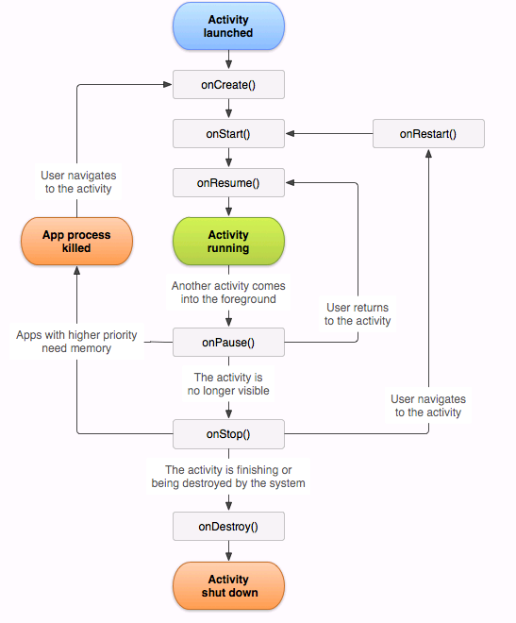
Activity: Lifecycle
Foreground lifetime
Visible lifetime
Entire lifetime

Slide 8
Activity: Lifecycle Callbacks
public class Activity extends ApplicationContext {
protected void onCreate(Bundle savedInstanceState);
protected void onStart();
protected void onRestart();
protected void onResume();
protected void onPause();
protected void onStop();
protected void onDestroy();
public void onSaveInstanceState(Bundle savedInstanceState)
}
Sample: ActivityLifecycle

Slide 9
Activity State and Ejection from Memory
Likelihood of being killed | Process state | Activity state
Least | Foreground (having or about to get focus) | Created Started Resumed
More | Background (lost focus) | Paused
Most | Background (not visible) | Stopped
 | Empty | Destroyed

Slide 10
Saving Activity State
To save additional state information for your activity, you must override onSaveInstanceState() and add key-value pairs to the Bundle object that is saved in the event that your activity is destroyed unexpectedly. The default implementation of this method saves transient information about the state of the activity's view hierarchy, such as the text in an EditText widget or the scroll position of a ListView widget.
static final String STATE_SCORE = "playerScore";
static final String STATE_LEVEL = "playerLevel";
@Override
public void onSaveInstanceState(Bundle savedInstanceState) {
// Save the user's current game state
savedInstanceState.putInt(STATE_SCORE, mCurrentScore);
savedInstanceState.putInt(STATE_LEVEL, mCurrentLevel);
// Always call the superclass so it can save the view hierarchy state
super.onSaveInstanceState(savedInstanceState);
}
To save persistent data, such as user preferences or data for a database, you should take appropriate opportunities when your activity is in the foreground. If no such opportunity arises, you should save such data during the onStop() method.

Slide 11
Restoring Activity State
When your activity is recreated after it was previously destroyed, you can recover your saved state from the Bundle that the system passes to your activity. Both the onCreate() and onRestoreInstanceState() callback methods receive the same Bundle that contains the instance state information. Because the onCreate() method is called whether the system is creating a new instance of your activity or recreating a previous one, you must check whether the state Bundle is null before you attempt to read it. If it is null, then the system is creating a new instance of the activity, instead of restoring a previous one that was destroyed.
@Override
protected void onCreate(Bundle savedInstanceState) {
super.onCreate(savedInstanceState); // Always call the superclass first
// Check whether we're recreating a previously destroyed instance
if (savedInstanceState != null) {
// Restore value of members from saved state
mCurrentScore = savedInstanceState.getInt(STATE_SCORE);
mCurrentLevel = savedInstanceState.getInt(STATE_LEVEL);
} else {
// Probably initialize members with default values for a new instance
}
}

Slide 12
Restoring Activity State
Instead of restoring the state during onCreate() you may choose to implement onRestoreInstanceState(), which the system calls after the onStart() method. The system calls onRestoreInstanceState() only if there is a saved state to restore, so you do not need to check whether the Bundle is null.
public void onRestoreInstanceState(Bundle savedInstanceState) {
// Always call the superclass so it can restore the view hierarchy
super.onRestoreInstanceState(savedInstanceState);
// Restore state members from saved instance
mCurrentScore = savedInstanceState.getInt(STATE_SCORE);
mCurrentLevel = savedInstanceState.getInt(STATE_LEVEL);
}

Slide 13
What can be put into Bundle
The Bundle object which is used to pass data to Android components is a key/value store for specialized objects. It is similar to a Map but can only contain these specialized objects
You can place the following objects types into a Bundle:
String
primitives
Serializable
Parcelable
If you need to pass your customer objects via a Bundle, you should implement the Parcelable interface.

Slide 14
Parcelable objects
The Bundle object which is used to pass data to Android components is a key/value store for specialized objects. It is similar to a Map but can only contain these specialized objects
You can place the following objects types into a Bundle:
String
primitives
Serializable
Parcelable
If you need to pass your customer objects via a Bundle, you should implement the Parcelable interface.
You may notice some similarities between Parcelable and Serializable. DO NOT attempt to persist Parcel data. It is meant for high-performance transport and you could lose data by trying to persist it.
Using Parcelable compared to Serializable can achieve up to 10x performance increase in many cases for transport which is why it's the Android preferred method.

Slide 15
Parcelable objects
public class Student implements Parcelable {
private long id;
private String name;
private String grade;
// Parcelling part
public Student(Parcel in){
this.id = in.readLong();
this.name = in.readString();
this.grade = in.readString();
}
@Override
public int describeContents() {
return 0;
}
@Override
public void writeToParcel(Parcel dest, int flags) {
dest.writeLong(this.id);
dest.writeString(this.name);
dest.writeString(this.grade);
}
public static final Parcelable.Creator CREATOR = new Parcelable.Creator() {
public Student createFromParcel(Parcel in) {
return new Student(in);
}
public Student[] newArray(int size) {
return new Student[size];
}
};
}

Slide 16
Parcelable objects
Once you have defined this, you can put it into the extra of an intent.
intent.putExtra("student", new Student("1","Mike","6"));
To access the parcel on the other side, you can use the following example code.
Bundle data = getIntent().getExtras();
Student student = (Student) data.getParcelable("student");
One very important thing to pay close attention to is the order that you write and read your values to and from the Parcel. They need to match up in both cases. The mechanism that Android uses to read the Parcel is blind and completely trusts you to get the order correct, or else you will run into run-time crashes.
You can only put primitives, lists and arrays, Strings, and other Parcelable objects into a Parcel. This means that you cannot store framework dependent objects that are not Parcelable. For example, you could not write a Drawable to a Parcel. Remember, Parcel is supposed to be fast and lightweight! (though it is interesting to see Bitmap implementing Parcelable)

Slide 17
Coordinating activities
When one activity starts another, they both experience lifecycle transitions. The first activity stops operating and enters the Paused or Stopped state, while the other activity is created. In case these activities share data saved to disc or elsewhere, it's important to understand that the first activity is not completely stopped before the second one is created. Rather, the process of starting the second one overlaps with the process of stopping the first one.
The order of lifecycle callbacks is well defined, particularly when the two activities are in the same process (app) and one is starting the other. Here's the order of operations that occur when Activity A starts Activity B:
A: onPause()
B: onCreate()
B: onStart()
B: onResume()
A: onStop()
This predictable sequence of lifecycle callbacks allows you to manage the transition of information from one activity to another.
Activity A
Activity B

Slide 18
Intents & Intent Filters

Slide 19
What is Intent?
An Android Intent is an abstract description of an operation to be performed. We can think of Intent as a declaration to perform some operation on some data. Intents are used as a message-passing mechanism that works both within application, and between applications.
Using Intents we can:
start other activities
pass broadcast intents to operating system
receive broadcast intents from operating system
communicate between components within one application or different applications
Implicit Intents
Dial a call
Open web site
Geo location
Intents
Explicit Intents
Broadcast receiving
Launch an activity
Start services

Slide 20
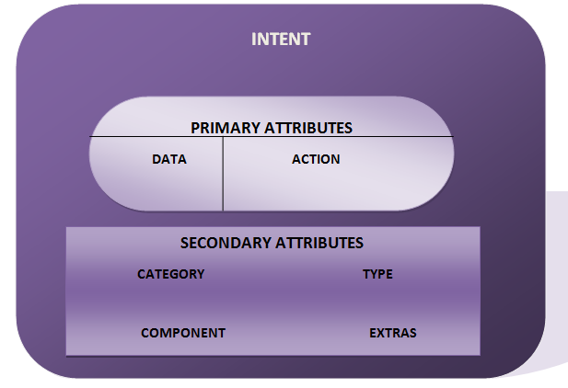
Intent Structure
Each intent must contain 2 primary parameters:
action -- The general action to be performed, such as ACTION_VIEW, ACTION_EDIT, ACTION_MAIN, etc.
data -- The data to operate on, such as a person record in the contacts database, expressed as a Uri.
In addition there are a number of optional parameters that you can also include with an intent:
category - gives additional information about the action to execute.
type - specifies an explicit type (a MIME type) of the intent data. Normally the type is inferred from the data itself. By setting this attribute, you disable that evaluation and force an explicit type.
component - specifies an explicit name of a component class to use for the intent. Normally this is determined by looking at the other information in the intent (the action, data/type, and categories) and matching that with a component that can handle it. If this attribute is set then none of the evaluation is performed, and this component is used exactly as is. By specifying this attribute, all of the other Intent attributes become optional.
extras - this is a Bundle of any additional information. This can be used to provide extended information to the component.

Slide 21
Intents: Standard Activity Actions
ACTION_MAIN
ACTION_VIEW
ACTION_ATTACH_DATA
ACTION_EDIT
ACTION_PICK
ACTION_CHOOSER
ACTION_GET_CONTENT
ACTION_DIAL
ACTION_CALL
ACTION_SEND
ACTION_SENDTO
ACTION_ANSWER
ACTION_INSERT
ACTION_DELETE
ACTION_RUN
ACTION_SYNC
ACTION_PICK_ACTIVITY
ACTION_SEARCH
ACTION_WEB_SEARCH
ACTION_FACTORY_TEST

Slide 22
Intents: Standard Categories
CATEGORY_DEFAULT
CATEGORY_BROWSABLE
CATEGORY_TAB
CATEGORY_ALTERNATIVE
CATEGORY_SELECTED_ALTERNATIVE
CATEGORY_LAUNCHER
CATEGORY_INFO
CATEGORY_HOME
CATEGORY_PREFERENCE
CATEGORY_TEST
CATEGORY_CAR_DOCK
CATEGORY_DESK_DOCK
CATEGORY_LE_DESK_DOCK
CATEGORY_HE_DESK_DOCK
CATEGORY_CAR_MODE
CATEGORY_APP_MARKET
CATEGORY_VR_HOME

Slide 23
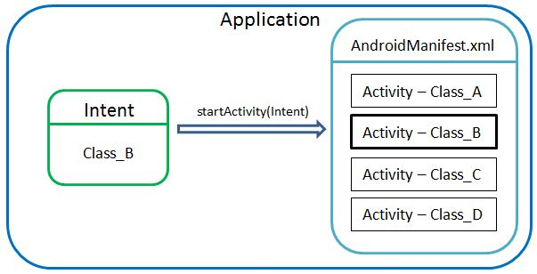
Explicit Intents
Run OtherActivity
Intent intent = new Intent(this, OtherActivity.class); startActivity(intent);
PackageManager manager = getPackageManager(); Intent chromeIntent = manager.getLaunchIntentForPackage("com.android.chrome"); if (chromeIntent != null) { startActivity(chromeIntent); }
Run Google Chrome

Slide 24
Intents: Data Exchange
Using Intents you can exchange data between Activities.
startActivityForResult(Intent intent, int requestCode);
onActivityResult(int requestCode, int resultCode, Intent data)
Parameters
intent | Intent: The intent to start.
requestCode | int: If >= 0, this code will be returned in onActivityResult() when the activity exits.
Parameters
requestCode | int: The integer request code originally supplied to startActivityForResult(), allowing you to identify who this result came from.
resultCode | int: The integer result code returned by the child activity through its setResult().
data | Intent: An Intent, which can return result data to the caller (various data can be attached to Intent "extras").

Slide 25
Intents: Data Exchange (MainActivity)
private static final int SHOW_OTHER_ACTIVITY = 1;
Intent intent = new Intent(this, OtherActivity.class); intent.putExtra(OtherActivity.GUESS, "Some guess"); startActivityForResult(intent, SHOW_OTHER_ACTIVITY);
public void onActivityResult(int requestCode, int resultCode, Intent data) { switch (requestCode) { case (SHOW_OTHER_ACTIVITY): if (resultCode == Activity.RESULT_OK) { boolean isCorrect = data.getBooleanExtra(OtherActivity.IS_CORRECT, false); if (isCorrect) { //TODO: process correct response } else { //TODO: process incorrect response } } break; } }
Pass data from MainActivity
Handle result

Slide 26
Intents: Data Exchange (OtherActivity)
public static final String IS_CORRECT = "ru.mera.anastasia.testproject.iscorrect"; public static final String GUESS = "testproject.guess";
Intent data = getIntent(); String guess = data.getStringExtra(GUESS); Intent result = new Intent(); result.putExtra(IS_CORRECT, isCorrect(guess)); setResult(RESULT_OK, result); finish();
Get data passed from MainActivity
Setting the result
Sample: ResultFromActivity

Slide 27
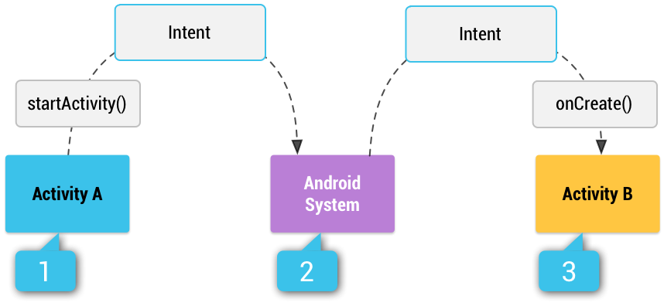
Implicit Intents
Implicit intents do not name a specific component, but instead declare a general action to perform, which allows a component from another app to handle it. For example, if you want to show the user a location on a map, you can use an implicit intent to request that another capable app show a specified location on a map.
Intent browserIntent = new Intent(Intent.ACTION_VIEW); browserIntent.setData(Uri.parse("http://www.google.com")); browserIntent.addCategory(Intent.CATEGORY_BROWSABLE); if (browserIntent.resolveActivity(getPackageManager()) != null) { startActivity(browserIntent); }
Run browser
Sample: SimpleCaller

Slide 28
Intent Filters
intent filter specifies the type of intents it accepts based on the intent's action, data, and category. Filters describe and advertise the capabilities of a component and informs the system which implicit intents a component can handle.
The system delivers an implicit intent to your app component only if the intent can pass through one of your intent filters.
If a component does not have any intent filters, it can receive only explicit intents.
A component with filters can receive both explicit and implicit intents.
A component has separate filters for each job it can do
Intent Filters are placed in AndroidManifest.xml
Sample: IntentResolution
<activity android:name=".OtherActivity"> <intent-filter> <action android:name="android.intent.action.VIEW" /> <category android:name="android.intent.category.DEFAULT" /> <data android:mimeType="vnd.android.cursor.item/vnd.ru.mera.anastasia.testproject"/> </intent-filter> </activity>

Slide 29
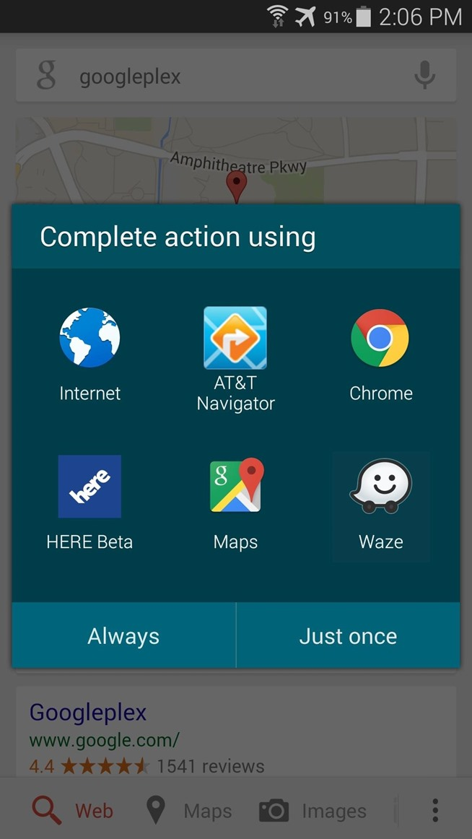
Intent Resolution Rules
An implicit Intent object are tested against an intent filter in three areas
Action
Data (both URI and data type)
Category
To be delivered to the component that owns the filter, it must pass all three tests.
If an intent can pass through the filters of one activity or service, this particular activity (service) is opened to handle the intent
If an intent can pass through the filters of more than one activity or service, the user may be asked which component to activate.
If no target can be found, an exception is raised

Slide 30
Broadcast Receivers

Slide 31
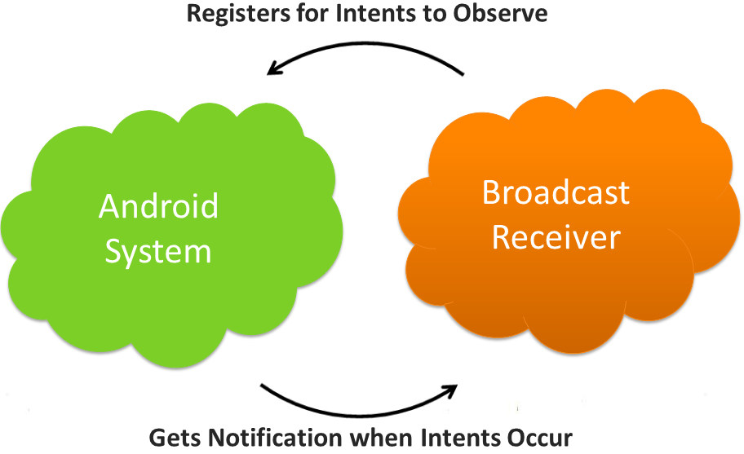
Broadcast Receivers
Broadcast Receivers simply respond to broadcast messages from other applications or from the system itself.
There are following two important steps to make BroadcastReceiver works for the system broadcasted intents −
Creating the Broadcast Receiver.
Registering Broadcast Receiver

Slide 32
Creating the Broadcast Receiver
A broadcast receiver is implemented as a subclass of BroadcastReceiver class and overriding the onReceive() method where each message is received as a Intent object parameter.
public class MyReceiver extends BroadcastReceiver {
@Override public void onReceive(Context context, Intent intent) {
Toast.makeText(context, "Intent Detected.", Toast.LENGTH_LONG).show();
}
}

Slide 33
Registering Broadcast Receiver
An application listens for specific broadcast intents by registering a broadcast receiver in AndroidManifest.xml file. Consider we are going to register MyReceiver for system generated event ACTION_BOOT_COMPLETED which is fired by the system once the Android system has completed the boot process.
<application android:icon="@drawable/ic_launcher"
android:label="@string/app_name"
android:theme="@style/AppTheme" >
<receiver android:name="MyReceiver">
<intent-filter>
<action android:name="android.intent.action.BOOT_COMPLETED">
</action>
</intent-filter>
</receiver>
</application>

Slide 34
Standard Broadcast Actions
ACTION_TIME_TICK
ACTION_TIME_CHANGED
ACTION_TIMEZONE_CHANGED
ACTION_BOOT_COMPLETED
ACTION_PACKAGE_ADDED
ACTION_PACKAGE_CHANGED
ACTION_PACKAGE_REMOVED
ACTION_PACKAGE_RESTARTED
ACTION_PACKAGE_DATA_CLEARED
ACTION_PACKAGES_SUSPENDED
ACTION_PACKAGES_UNSUSPENDED
ACTION_UID_REMOVED
ACTION_BATTERY_CHANGED
ACTION_POWER_CONNECTED
ACTION_POWER_DISCONNECTED
ACTION_SHUTDOWN

Slide 35
Broadcasting Custom Intents
If you want your application itself should generate and send custom intents then you will have to create and send those intents by using the sendBroadcast() method inside your activity class. If you use the sendStickyBroadcast(Intent) method, the Intent is sticky, meaning the Intent you are sending stays around after the broadcast is complete.
public void broadcastIntent(View view) {
Intent intent = new Intent();
intent.setAction("com.tutorialspoint.CUSTOM_INTENT");
sendBroadcast(intent);
}
<application
android:icon="@drawable/ic_launcher"
android:label="@string/app_name"
android:theme="@style/AppTheme" >
<receiver android:name="MyReceiver">
<intent-filter>
<action android:name="com.tutorialspoint.CUSTOM_INTENT">
</action>
</intent-filter>
</receiver>
</application>
This intent com.tutorialspoint.CUSTOM_INTENT can also be registered in similar way as we have registered system generated intent.

